Slide 1
Daily Review
CFU 1
Which are larger DNA or genes?
Genes
DNA in chromosomes consists of small sections that are called genes, which determine characteristics of an organism
The different orders in which the nitrogenous bases are arranged within a gene, are what gives the individual their unique characteristics
E.g. hair colour, eye colour, skin colour
Genes are passed down from parents to offspring
This is why family members often share similar traits
Alleles
Alleles are alternate forms of a gene which occupy the identical location on homologous chromosome.
Alleles control the contrasting characteristic of each trait.
CFU 2
Explain the relationship between genes and alleles

Slide 2
Mutations and Variation

Slide 3
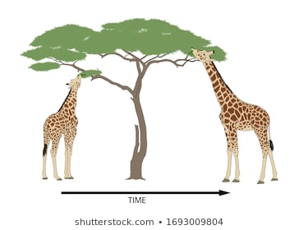
Learning Objectives
CFU
What are we going to learn?
Describe the process of mutation
Identify different mutagens and their effect
Activate Prior Knowledge
Look at the two giraffes on the right.
What differences can you observe in the giraffes?
What advantage does the giraffe on the right have over the giraffe on the left?
Which giraffe is more likely to live and pass on its genes?

Slide 4
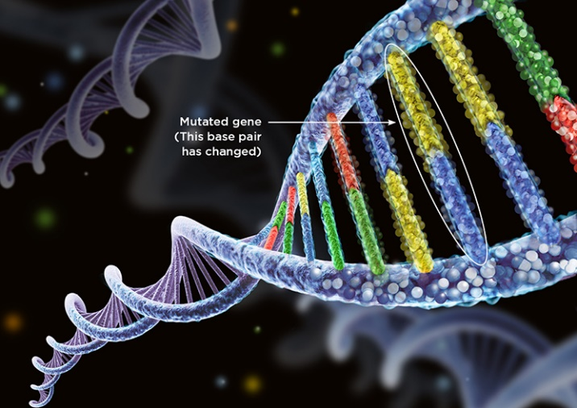
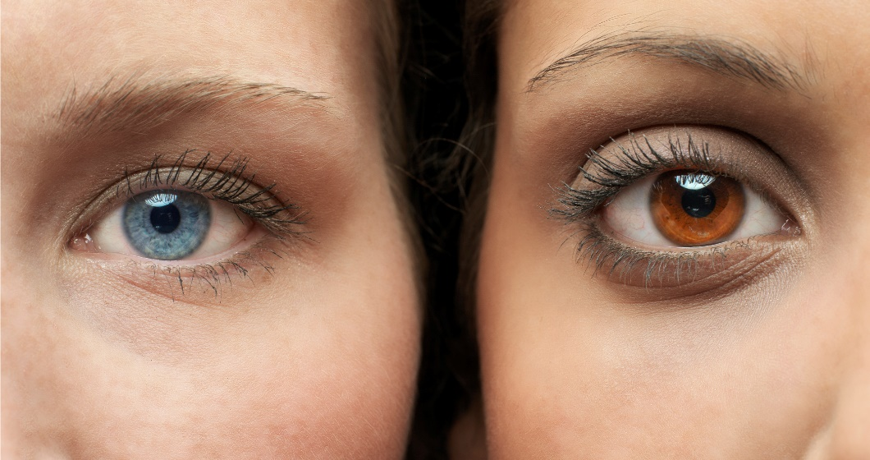
Concept Development
CFU 1
How does genetic mutation affect the DNA?
Genetic Mutation
Permanent change in the DNA sequence
Can be in one gene or more genes
DNA replication requires copying a huge number of base pairs
Mistakes occasionally happen leading to natural mutation
Thousands of years ago, a mutation in the brown eye gene lead to the addition of the blue eye allele to the gene pool
Genetic mutation can be either beneficial, detrimental to a species
However most mutations have NO EFFECT
CFU 2
What effect do mutations have the majority of the time?

Slide 5
Concept Development
CFU 1
What is a mutagen?
Mutagens
Mutations occur naturally however some factors can affect the chance of mutation
These are known as Mutagens and include;
Radiation – such as Xrays
Chemicals – such as chemicals in tobacco and alcohol
UV light – from the sun, or in solariums
These mutagens lead to increased rates of negative mutations that are harmful
CFU 2
List two mutagens and give an example of each
CFU 3
How do mutagens affect the chance of genetic mutation?

Slide 6
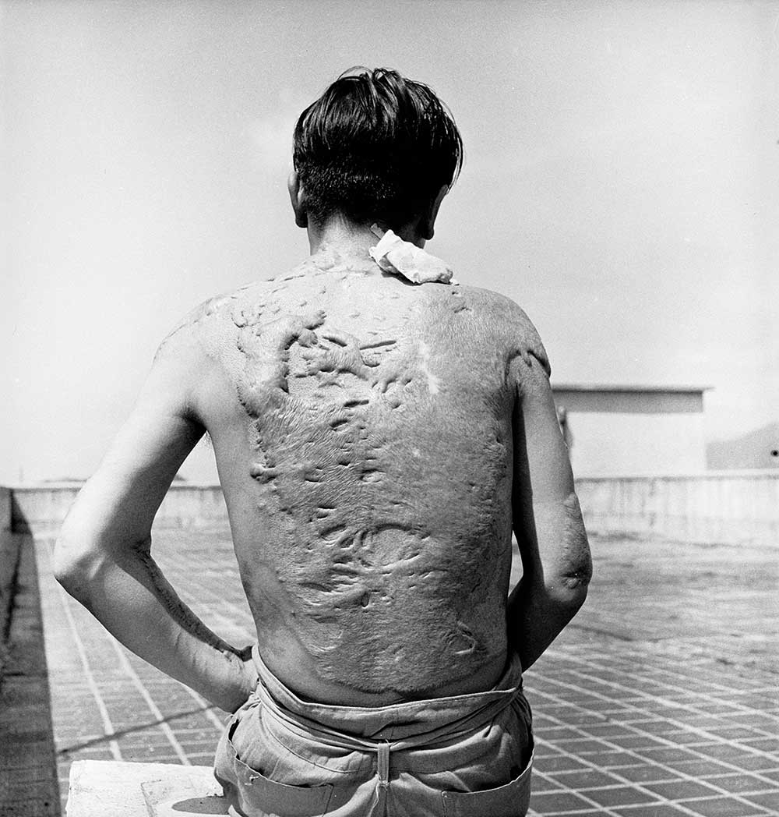
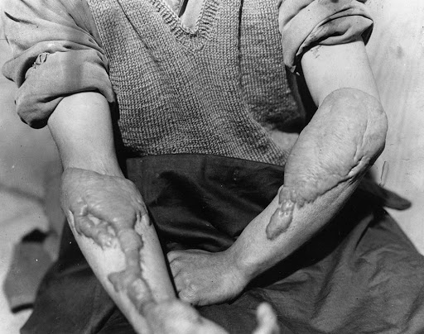
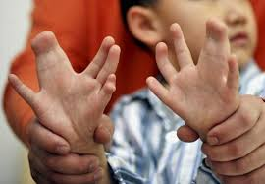
Concept Development
Negative Mutations
Radiation – harm can occur over a long period of time
Chernobyl – exposed thousands of people to high doses of radiation. Caused severe cellular mutation and damage resulting in thousands of deaths.
Hiroshima – Nuclear bomb at the end of WWII. Lead to the death of tens of thousands of people due to side effects of radiation exposure.
Mutations resulting from Hiroshima

Slide 7
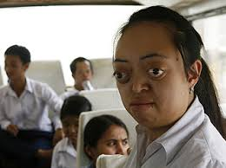
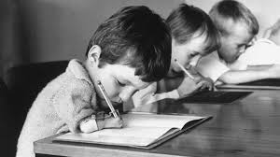
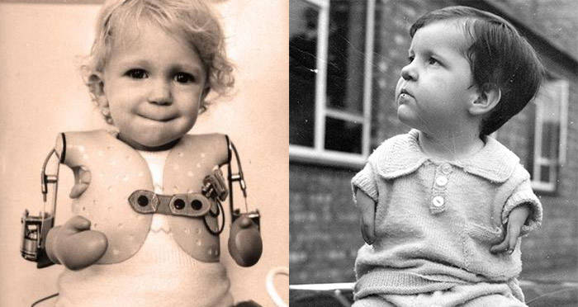
Concept Development
CFU 1
List 2 examples of chemical mutagens
Negative Mutations
Chemical
Tobacco/alcohol – May lead to mutation of tissue (mouth, lung etc) resulting in cancer
Thalidomide – A medicine prescribed in 50s and 60s for treatment of morning sickness that lead to sever birth defects in children
Birth defects from agent orange (Vietnam war)
Birth defects from thalidomide

Slide 8
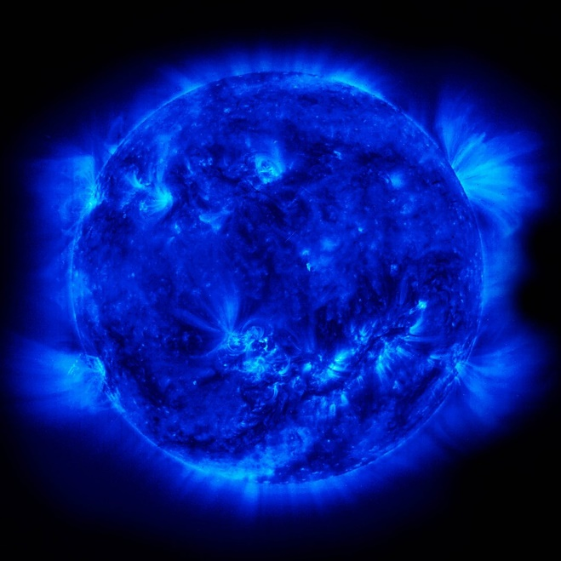
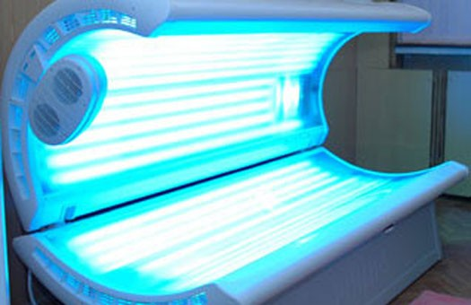
Concept Development
CFU 1
Why are solariums banned in Australia?
Negative Mutations
UV exposure
Skin cancer – over exposure to UV light (from the sun or solariums) can lead to mutations in skin cells leading to cancer.
Researched showed use of a solarium before the age of 35 increased risk of melanoma by 59%. Solariums are now banned in Australia

Slide 9
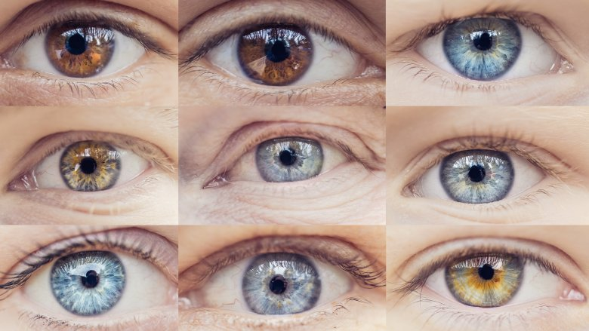
Concept Development
Variation
Although some mutations are harmful, other mutations are beneficial for the survival of a species (we call these adaptations – Yr 7)
Some naturally occurring mutations lead to the production of new alleles
These new alleles lead to a more diverse gene pool and therefore variation within species
Genetic variation is important within species as it:
Allows species to adapt to changes in the environment
Allows the ongoing survival of the species
CFU 1
True or False: Beneficial mutations are caused by mutagens?
CFU 2
Why is genetic variation important?

Slide 10
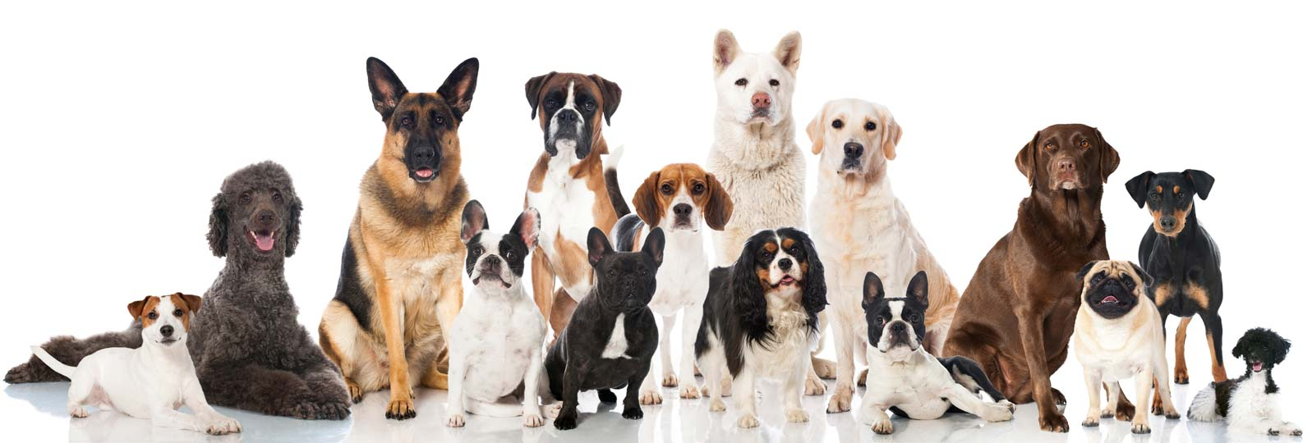
Concept Development
CFU 1
Define the term species
Mutations create species
Over time advantageous mutations lead to the creation of different species
Species - The largest group of organisms in which any two individuals can produce fertile offspring
Examples of species are;
Dogs
Humans
Bears
If you think about any of these species you can identify obvious variations between its members
E.g. Polar bears are white, Grizzly bears are brown
https://www.youtube.com/watch?v=I5lTZ0bfqqI
CFU 2
Which different variations can you think of in the human species?

Slide 11
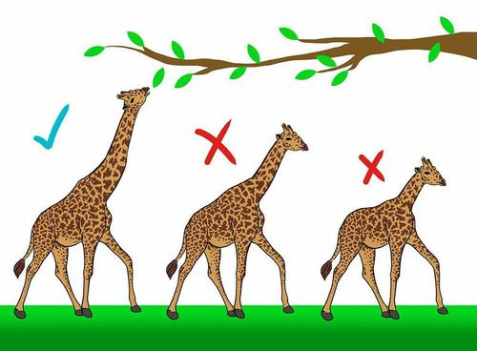
Concept Development
CFU 1
True or False: All mutations lead to adaptations
Adaptations
A small number of these mutations may lead to adaptations
A characteristic or behaviour that allows a species to survive more effectively.
Animals that develop adaptations more suited to survival are more likely to live, and therefore more likely to pass on their genes
We call this process Natural Selection
CFU 2
Think back to the giraffe. Which giraffe is most likely to survive? Why?

Slide 12
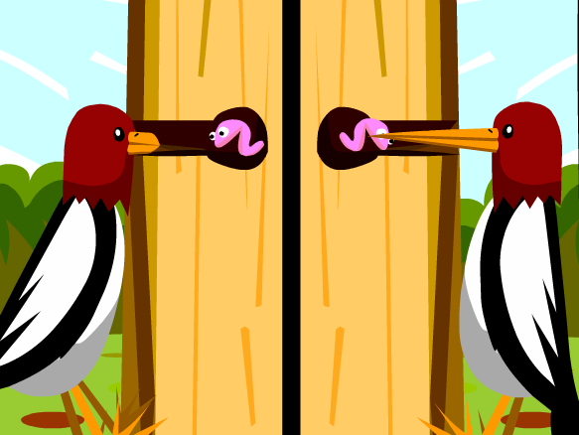
Skill Development/Guided Practice
Which of the wood peckers has developed a useful adaptation?
Why is it more likely to survive?
The wood pecker on the right has adapted a long beak.
Because of this it can get its food more easily and is more likely to survive.

Slide 13
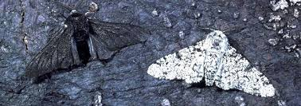
Skill Development/Guided Practice
Which of the peppered moths has developed a useful adaptation?
Why is it more likely to survive?
The peppered moth on the left is black.
Because of this it can hide from predators more easily and is more likely to survive.

Slide 14
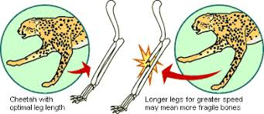
Relevance
Mutations occur all the time, only a small number are noticeable.
Some mutations lead to the development of new and useful genes. These help the animal to survive and are called adaptations.
Understanding how genetic variation and adaptations affect a species will help you to understand the processes of natural selection and evolutions.
Note: some adaptations are detrimental to a species. If a cheetah’s legs are too long, they can run fast, however they are more likely to injure themselves.

Slide 15
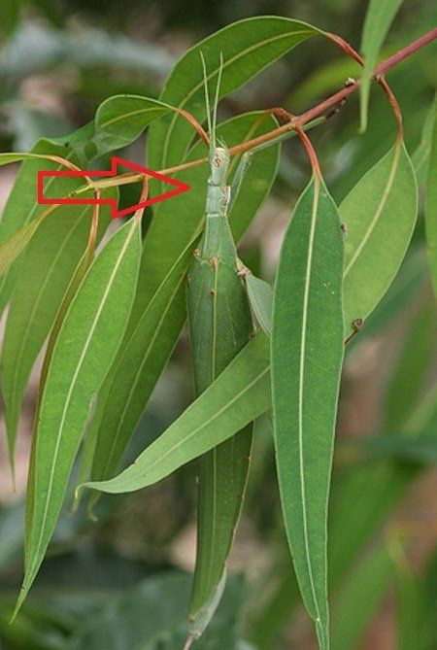
Skill Closure
List three mutagens
Skill Closure
Explain why variation within a species is important
Skill Closure
How has this insect adapted, and how does this allow it to survive?

Slide 16
Independent Practice
Complete pages 40-43 in Oxford Science 10
Marigold
Rafflesia
Trumpet Vine
Cactus
Jasmine
Bottlebrush

